Slide 1

CSCE 5218
Deep Learning
Neural Network Training
Slides adapted from Adriana Kovashka

Slide 2
Convergence of training

Slide 3
Successful training
We want training to converge (stop) at a reasonable place
Stopping is not guaranteed – e.g. imagine taking larger and larger steps…
Stopping in a good place is not guaranteed

Slide 4
Loss surfaces
Usually Loss(W) is not convex, so there could be many local minima
However, in deep networks, these minima are reasonably similar – not true in small networks
What are desirable properties of the loss surface?

Slide 5
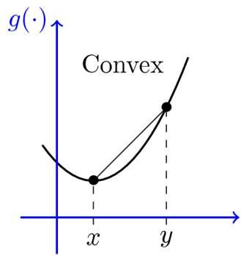
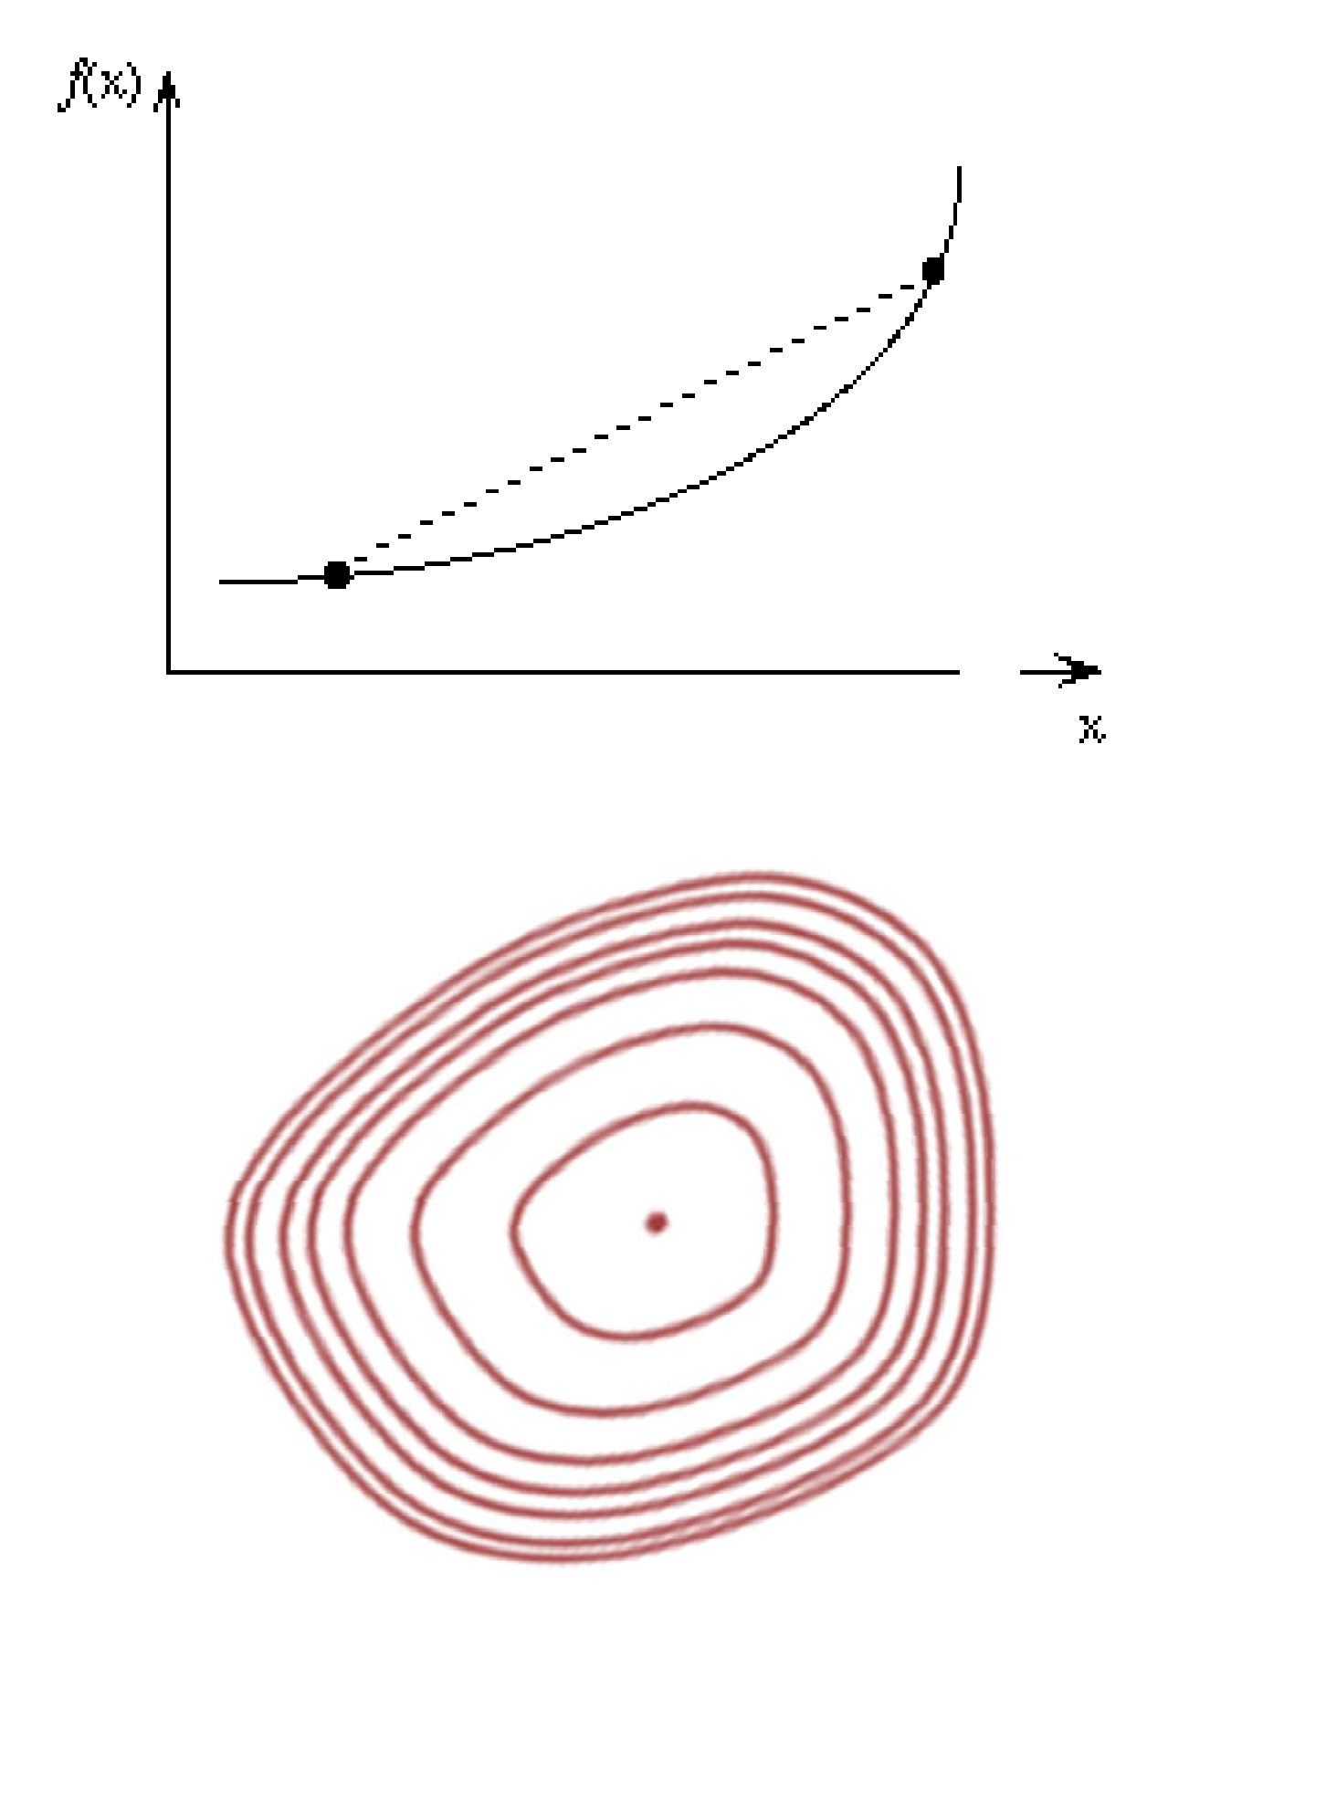
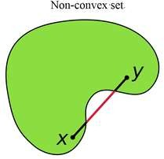
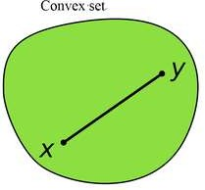
Convexity
A surface is “convex” if it continuously curves upward
  We can connect any two points above the surface without intersecting it
  Many mathematical definitions that are equivalent
Caveat: Neural net loss surface generally not convex
Non-convex set
Convex set
Adapted from Bhiksha Raj

Slide 6
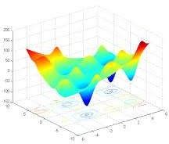
The loss surface
Gradient descent makes the assumption that loss/objective has a single global optimum
What about local optima?
Adapted from Bhiksha Raj

Slide 7
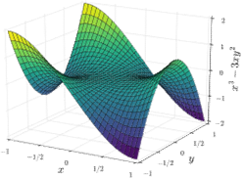
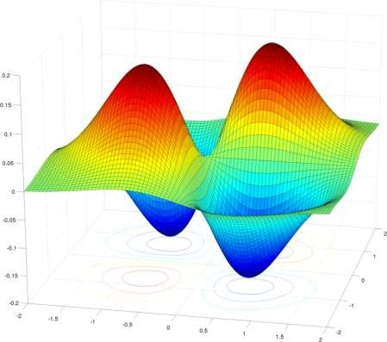
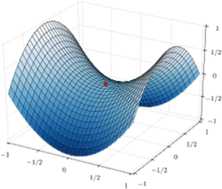
The loss surface
Popular hypothesis:
  Most local minima are equivalent
    And close to global minimum
  This is not true for small networks
  In large networks, saddle points are far more common than local minima
Saddle point: A point where:
  The slope is zero
  The surface increases in some directions, but decreases in others
    Some of the Eigenvalues of the Hessian are positive; others are negative
  Gradient descent algs often get “stuck” in saddle points
Bhiksha Raj

Slide 8
Conditions for convergence
So far we have assumed training arrives at a local minimum
Does it always converge?
How long does it take?
Hard to analyze for a neural network, but we can look at the problem through the lens of convex optimization
Adapted from Bhiksha Raj

Slide 9
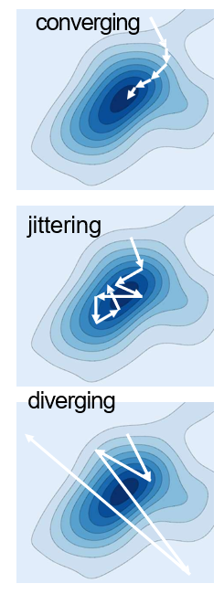
Convergence and convergence rate
An iterative algorithm is said to converge to a solution if the value updates arrive at a fixed point
  Where the gradient is 0 and further updates do not change the estimate
The algorithm may not converge
  It may jitter around the local minimum
  It may even diverge
Bhiksha Raj

Slide 10
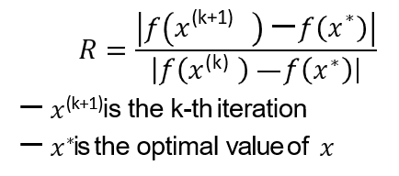
Convergence and convergence rate
Convergence rate: how fast iterations arrive at the solution
Generally quantified as:
If R is a constant (or upper-bounded): convergence is linear
Adapted from Bhiksha Raj

Slide 11
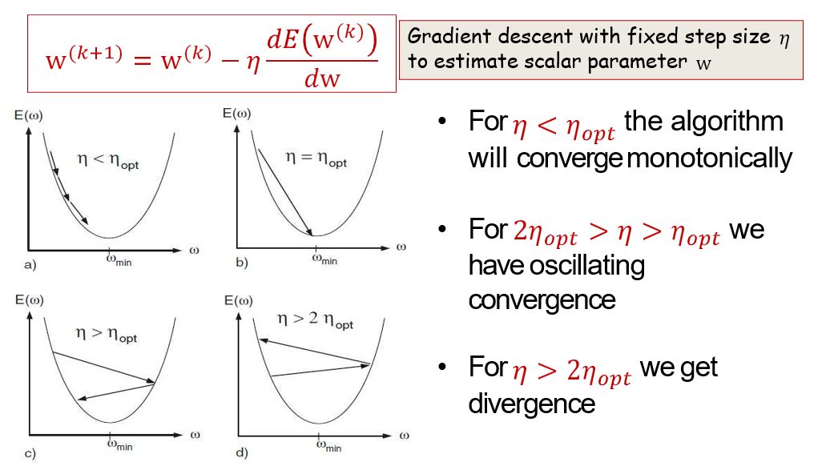
With non-optimal step size
Bhiksha Raj

Slide 12
Optimization strategies

Slide 13
Getting to the minimum
Gradient descent is just one strategy, but has several problems
What other “steps” can we take?
How far in the direction of decreasing gradient do we go? With what speed/acceleration?
What about overshooting minima?

Slide 14
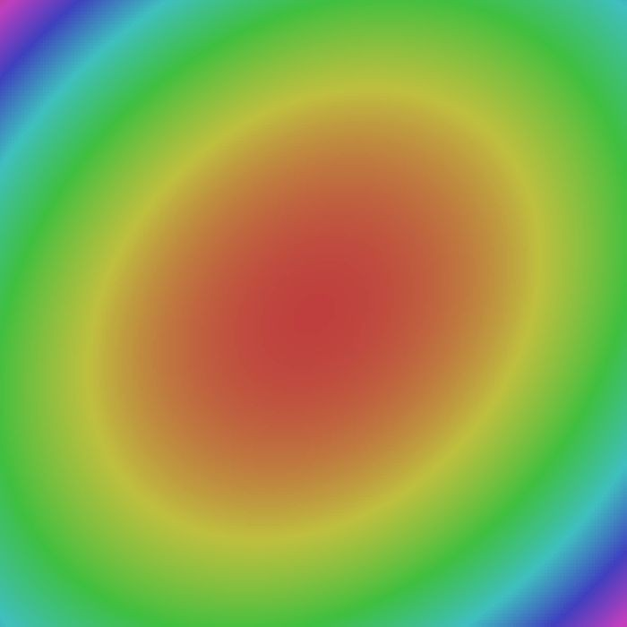
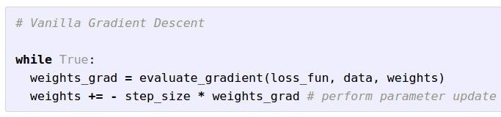

Optimization
W_2
W_1
Fei-Fei Li & Justin Johnson & Serena Yeung Lecture 7 - April 24, 2018
Fei-Fei Li, Andrej Karpathy, Justin Johnson, Serena Yeung

Slide 15
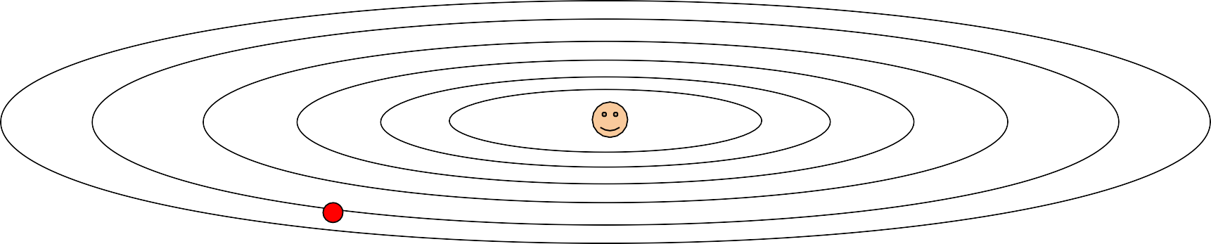
Optimization:
Problems with SGD
What if loss changes quickly in one direction and slowly in another? What does gradient descent do?
Fei-Fei Li & Justin Johnson & Serena Yeung Lecture 7 - April 24, 2018
Fei-Fei Li, Andrej Karpathy, Justin Johnson, Serena Yeung

Slide 16
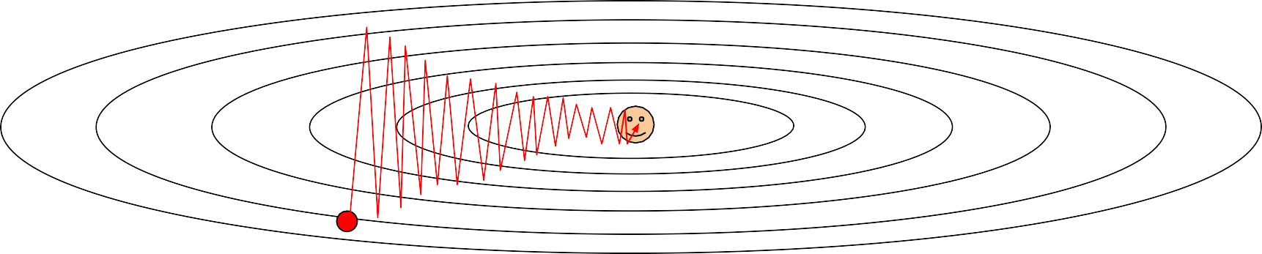
Optimization:
Problems with SGD
What if loss changes quickly in one direction and slowly in another? What does gradient descent do?
Very slow progress along shallow dimension, jitter along steep direction
Fei-Fei Li & Justin Johnson & Serena Yeung Lecture 7 - April 24, 2018
Fei-Fei Li, Andrej Karpathy, Justin Johnson, Serena Yeung

Slide 17


Optimization:
Problems with SGD
What if the loss function has a local minima or saddle point?
Zero gradient, gradient descent gets stuck
Fei-Fei Li & Justin Johnson & Serena Yeung Lecture 7 - April 24, 2018
Fei-Fei Li, Andrej Karpathy, Justin Johnson, Serena Yeung

Slide 18
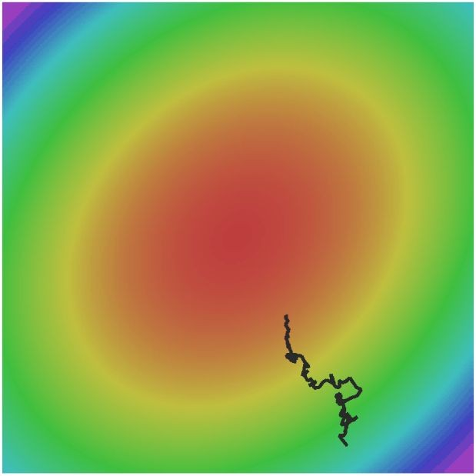
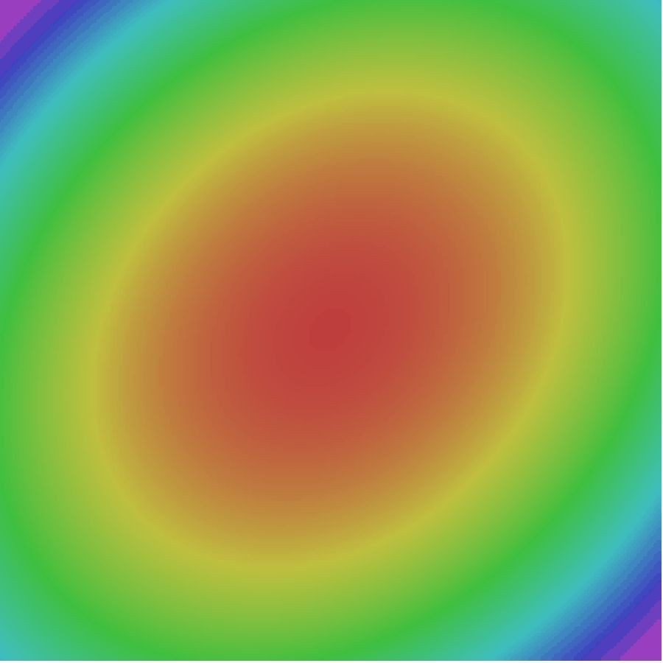
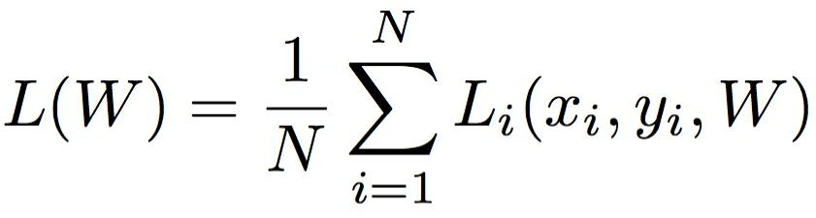
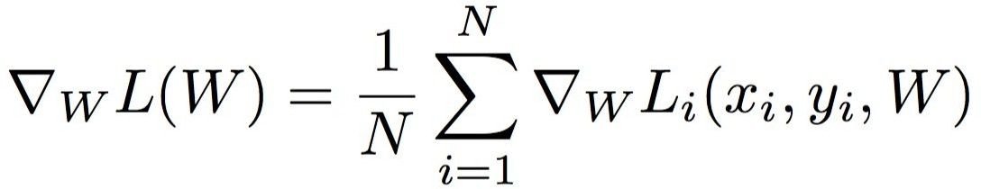
Optimization:
Problems with SGD
Our gradients come from minibatches so they can be noisy!
Fei-Fei Li & Justin Johnson & Serena Yeung Lecture 7 - April 24, 2018
Fei-Fei Li, Andrej Karpathy, Justin Johnson, Serena Yeung

Slide 19
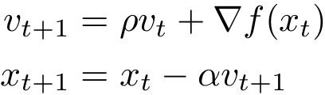

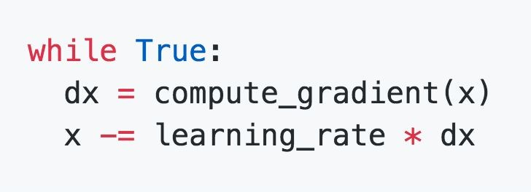
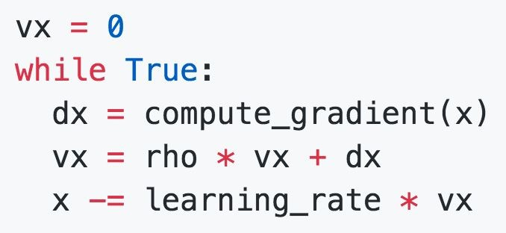
SGD + Momentum
SGD
SGD+Momentum
Build up “velocity” as a running mean of gradients
Rho gives “friction”; typically rho=0.9 or 0.99
Sutskever et al, “On the importance of initialization and momentum in deep learning”, ICML 2013
Fei-Fei Li & Justin Johnson & Serena Yeung Lecture 7 - April 24, 2018
Fei-Fei Li, Andrej Karpathy, Justin Johnson, Serena Yeung
Notes:
问题在哪里？
震荡严重. 在“狭长峡谷”型 loss landscape 里，会左右来回抖
对噪声敏感. mini-batch 的梯度噪声会直接影响更新方向
收敛慢. 每一步都像“重新开始思考”，没有记忆
SGD 是健忘的。
Momentum：核心思想一句话: 不要只看这一刻的梯度，要“记住过去的方向” (不是每一步都完全听当前坡度的)
加速收敛
连续同方向的梯度 → 越走越快
像滚雪球一样
抗噪声
单个 batch 的异常梯度影响被“平均掉”

Slide 20
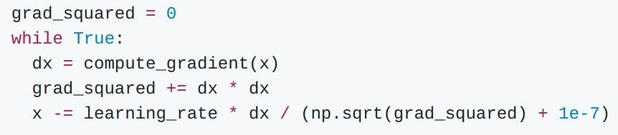
AdaGrad
Added element-wise scaling of the gradient based on the historical sum of squares in each dimension
“Per-parameter learning rates” or “adaptive learning rates”
Duchi et al, “Adaptive subgradient methods for online learning and stochastic optimization”, JMLR 2011
Fei-Fei Li & Justin Johnson & Serena Yeung Lecture 7 - April 24, 2018
Fei-Fei Li, Andrej Karpathy, Justin Johnson, Serena Yeung
Notes:
如果某个参数：
历史上梯度平方和很大
→ 说明它已经被反复优化
→ 降低它的学习率
如果某个参数：
历史梯度平方和很小
→ 说明它很少被碰
→ 保持大学习率
梯度一直很大 → grad_squared 很大 → 更新被压小
梯度很少出现 → grad_squared 小 → 更新仍然大
不是巧合，是必然：
梯度有正有负，不能直接累加
平方：
衡量的是 “更新强度”
和方向无关

Slide 21

AdaGrad
Q: What happens with AdaGrad?
Fei-Fei Li & Justin Johnson & Serena Yeung Lecture 7 - April 24, 2018
Fei-Fei Li, Andrej Karpathy, Justin Johnson, Serena Yeung

Slide 22
AdaGrad
Q: What happens with AdaGrad?
Progress along “steep” directions is damped; progress along “flat” directions is accelerated
Fei-Fei Li & Justin Johnson & Serena Yeung Lecture 7 - April 24, 2018
Fei-Fei Li, Andrej Karpathy, Justin Johnson, Serena Yeung

Slide 23

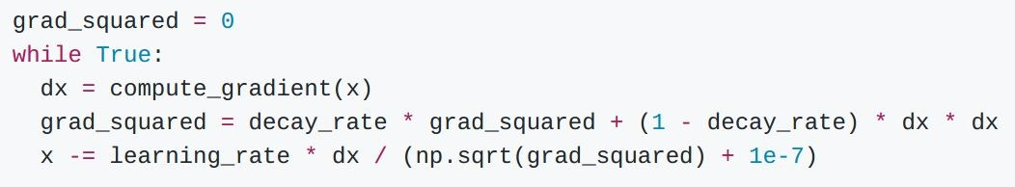
RMSProp (Root Mean Squared Propagation)
AdaGrad
RMSProp
Tieleman and Hinton, 2012
Fei-Fei Li & Justin Johnson & Serena Yeung Lecture 7 - April 24, 2018
Fei-Fei Li, Andrej Karpathy, Justin Johnson, Serena Yeung
Notes:
RMSProp 的动机是：
AdaGrad 的“历史记忆太长了”，
我们只想记住“最近一段时间”的梯度强度。
具体来说：
只要某个参数：
在早期梯度大过
那么：
grad_squared 会一直很大
即使后面梯度已经变小
学习率也 永远回不来 （学习率 → 0）
RMSProp
我不关心你“一辈子”更新得多不多，
我只关心你“最近表现怎么样”。
很久以前的梯度
→ 应该慢慢忘掉
最近的梯度
→ 才有参考价值

Slide 24
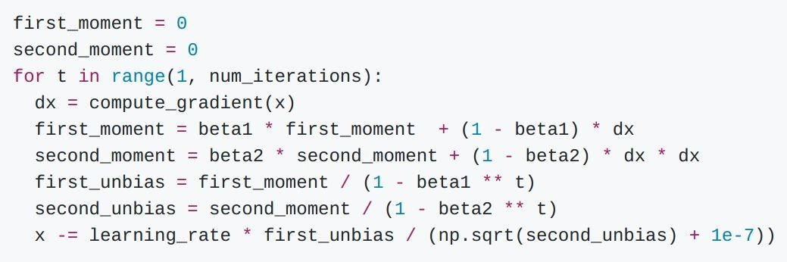
Adam
Momentum
Bias correction
AdaGrad / RMSProp
Bias correction for the fact that first and second moment estimates start at zero
Adam with beta1 = 0.9,
beta2 = 0.999, and learning_rate = 1e-3 or 5e-4 is a great starting point for many models!
Kingma and Ba, “Adam: A method for stochastic optimization”, ICLR 2015
Fei-Fei Li & Justin Johnson & Serena Yeung Lecture 7 - April 24, 2018
Fei-Fei Li, Andrej Karpathy, Justin Johnson, Serena Yeung
Notes:
beta1 = 0.9
第 1 步梯度是 g
不做 bias correction 时：
m1 = 0.9 * 0 + 0.1 * g = 0.1 g
但问题是：
你真正想要的“梯度均值”明明是 g
却被硬生生压成了 0.1 g

Slide 25
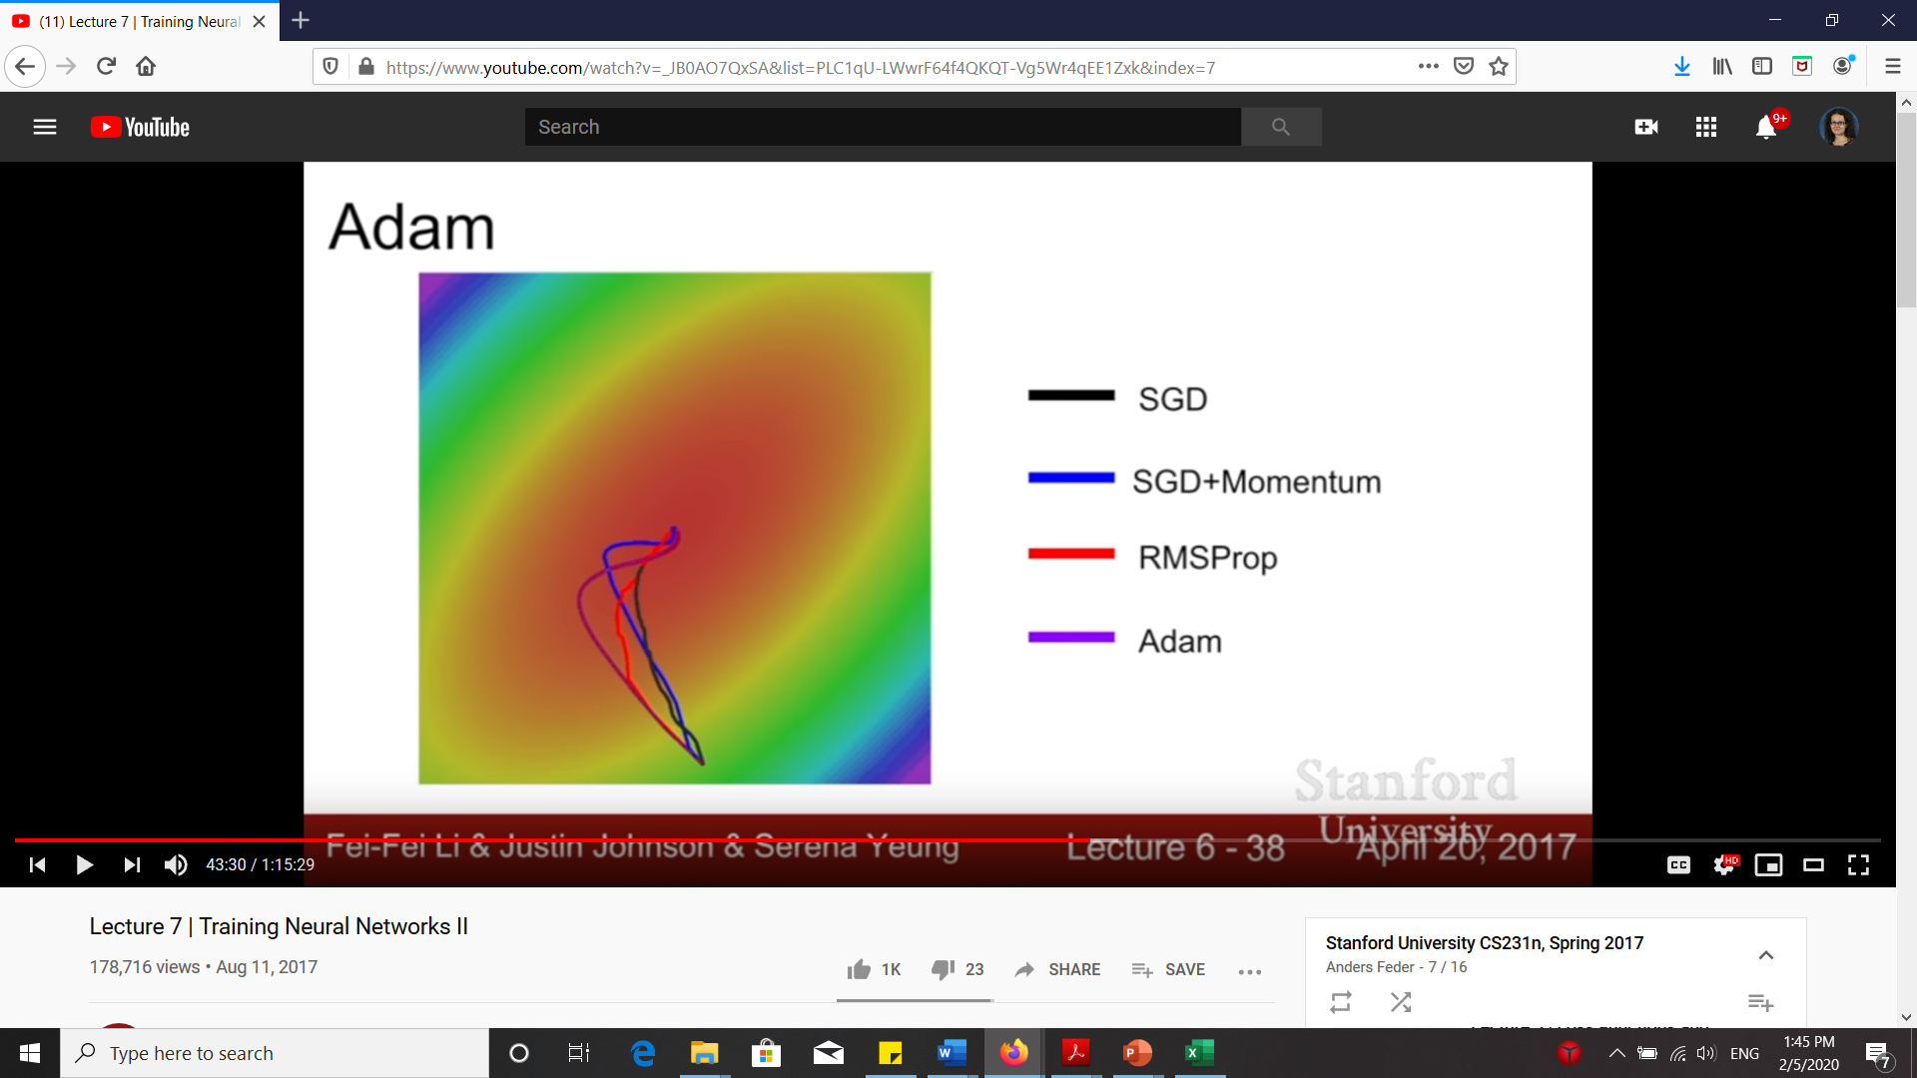
Optimizers comparison
https://imgur.com/a/Hqolp
Fei-Fei Li, Andrej Karpathy, Justin Johnson, Serena Yeung

Slide 26
Visualization
https://www.deeplearning.ai/ai-notes/optimization/
(bottom of page)
“In this visualization, you can compare optimizers applied to different cost functions and initialization. For a given cost landscape (1) and initialization (2), you can choose optimizers, their learning rate and decay (3). Then, press the play button to see the optimization process (4). There's no explicit model, but you can assume that finding the cost function's minimum is equivalent to finding the best model for your task.”

Slide 27
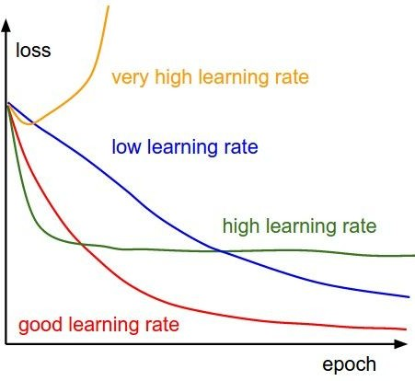


SGD, SGD+Momentum, Adagrad, RMSProp, Adam all have
learning rate as a hyperparameter.
=> Learning rate decay over time!
step decay:
e.g. decay learning rate by half every few epochs.
exponential decay:
1/t decay:
Fei-Fei Li & Justin Johnson & Serena Yeung Lecture 7 - April 24, 2018
Fei-Fei Li, Andrej Karpathy, Justin Johnson, Serena Yeung

Slide 28
SGD, SGD+Momentum, Adagrad, RMSProp, Adam all have
learning rate as a hyperparameter.
Q: Which one of these learning rates is best to use?
Lecture 7 -
Fei-Fei Li & Justin Johnson & Serena Yeung Lecture 7 - April 24, 2018
Fei-Fei Li, Justin Johnson, Serena Yeung

Slide 29
SGD, SGD+Momentum, Adagrad, RMSProp, Adam all have
learning rate as a hyperparameter.
Q: Which one of these learning rates is best to use?
A: All of them! Start with large learning rate and decay over time
Lecture 7 -
Fei-Fei Li & Justin Johnson & Serena Yeung Lecture 7 - April 24, 2018
Fei-Fei Li, Justin Johnson, Serena Yeung

Slide 30
SGD, SGD+Momentum, Adagrad, RMSProp, Adam all have
learning rate as a hyperparameter.
Loss
Learning rate decay!
Epoch
Fei-Fei Li & Justin Johnson & Serena Yeung Lecture 7 - April 24, 2018
Also see https://openreview.net/pdf?id=r1eOnh4YPB
Adapted from Fei-Fei Li, Andrej Karpathy, Justin Johnson, Serena Yeung

Slide 31
Loss
Bad initialization a prime suspect
time
Lecture 7 -
Fei-Fei Li & Justin Johnson & Serena Yeung Lecture 7 - April 24, 2018
Fei-Fei Li, Justin Johnson, Serena Yeung

Slide 32
Loss
Loss plateaus: Try learning rate decay
time
Lecture 7 -
32
Fei-Fei Li & Justin Johnson & Serena Yeung Lecture 7 - April 25, 2019
Fei-Fei Li, Justin Johnson, Serena Yeung

Slide 33
Loss
Learning rate step decay
Loss was still going down when learning rate dropped, you decayed too early!
time
Lecture 7 -
33
Fei-Fei Li & Justin Johnson & Serena Yeung Lecture 7 - April 25, 2019
Fei-Fei Li, Justin Johnson, Serena Yeung

Slide 34
Choosing Hyperparameters
Step 1: Check initial loss
Without weight decay (regularization), sanity check loss at initialization
e.g. log(C) for softmax with C classes
Lecture 7 -
Fei-Fei Li & Justin Johnson & Serena Yeung Lecture 7 - April 24, 2018
Adapted from Fei-Fei Li, Justin Johnson, Serena Yeung

Slide 35
Choosing Hyperparameters
Step 1: Check initial loss
Step 2: Overfit a small sample
Try to train to 100% training accuracy on a small sample of training data (~5-10 minibatches); fiddle with architecture, learning rate, weight initialization
Loss not going down? LR too low, bad initialization
Loss explodes to Inf or NaN? LR too high, bad initialization
Lecture 7 -
Fei-Fei Li & Justin Johnson & Serena Yeung Lecture 7 - April 24, 2018
Fei-Fei Li, Justin Johnson, Serena Yeung

Slide 36
Choosing Hyperparameters
Step 1: Check initial loss
Step 2: Overfit a small sample
Step 3: Find LR that makes loss go down
Use the architecture from the previous step, use all training data, turn on small weight decay, find a learning rate that makes the loss drop significantly within ~100 iterations
Good learning rates to try: 1e-1, 1e-2, 1e-3, 1e-4
Good weight decay to try: 1e-4, 1e-5, 0
Lecture 7 -
Fei-Fei Li & Justin Johnson & Serena Yeung Lecture 7 - April 24, 2018
Adapted from Fei-Fei Li, Justin Johnson, Serena Yeung

Slide 37
Choosing Hyperparameters
Step 1: Check initial loss
Step 2: Overfit a small sample
Step 3: Find LR that makes loss go down
Step 4: Coarse grid search, train for ~1-5 epochs
Choose a few values of learning rate and weight decay around what worked from Step 3, train a few models for ~1-5 epochs.
Lecture 7 -
Fei-Fei Li & Justin Johnson & Serena Yeung Lecture 7 - April 24, 2018
Adapted from Fei-Fei Li, Justin Johnson, Serena Yeung

Slide 38
Choosing Hyperparameters
Step 1: Check initial loss
Step 2: Overfit a small sample
Step 3: Find LR that makes loss go down
Step 4: Coarse grid, train for ~1-5 epochs
Step 5: Refine grid, train longer
Pick best models from Step 4, train them for longer (~10-20 epochs) without learning rate decay
Lecture 7 -
Fei-Fei Li & Justin Johnson & Serena Yeung Lecture 7 - April 24, 2018
Fei-Fei Li, Justin Johnson, Serena Yeung

Slide 39
Choosing Hyperparameters
Step 1: Check initial loss
Step 2: Overfit a small sample
Step 3: Find LR that makes loss go down
Step 4: Coarse grid, train for ~1-5 epochs Step 5: Refine grid, train longer
Step 6: Look at loss curves
Lecture 7 -
Fei-Fei Li & Justin Johnson & Serena Yeung Lecture 7 - April 24, 2018
Fei-Fei Li, Justin Johnson, Serena Yeung

Slide 40
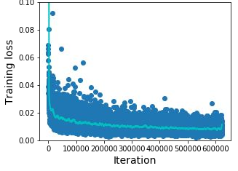
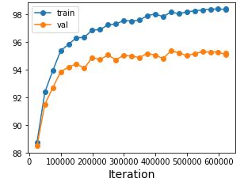
Look at learning curves!
Training Loss
Train / Val Accuracy
Losses may be noisy, use a scatter plot and also plot moving average to see trends better
Lecture 7 -
Fei-Fei Li & Justin Johnson & Serena Yeung Lecture 7 - April 24, 2018
Fei-Fei Li, Justin Johnson, Serena Yeung

Slide 41
Accuracy still going up, you need to train longer
Accuracy
Train
Val
time
Lecture 7 -
41
Fei-Fei Li & Justin Johnson & Serena Yeung Lecture 7 - April 25, 2019
Fei-Fei Li, Justin Johnson, Serena Yeung

Slide 42
Huge train / val gap means overfitting! Increase regularization, get more data
Accuracy
Train
Val
time
Lecture 7 -
42
Fei-Fei Li & Justin Johnson & Serena Yeung Lecture 7 - April 25, 2019
Fei-Fei Li, Justin Johnson, Serena Yeung

Slide 43
No gap between train / val means underfitting: train longer, use a bigger model
Accuracy
Train
Val
time
Lecture 7 -
43
Fei-Fei Li & Justin Johnson & Serena Yeung Lecture 7 - April 25, 2019
Fei-Fei Li, Justin Johnson, Serena Yeung

Slide 44
Model Ensembles
Train multiple independent models
At test time average their results
(Take average of predicted probability distributions, then choose argmax)
Enjoy 2% extra performance
Lecture 7 -
Fei-Fei Li & Justin Johnson & Serena Yeung Lecture 7 - April 24, 2018
Fei-Fei Li, Justin Johnson, Serena Yeung

Slide 45
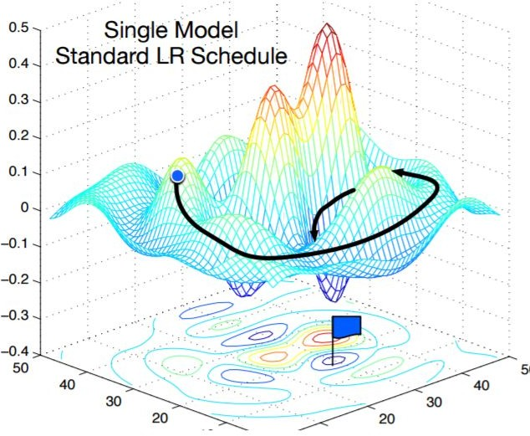
Model Ensembles: Tips and Tricks
Instead of training independent models, use multiple snapshots of a single model during training!
Loshchilov and Hutter, “SGDR: Stochastic gradient descent with restarts”, arXiv 2016 Huang et al, “Snapshot ensembles: train 1, get M for free”, ICLR 2017
Figures copyright Yixuan Li and Geoff Pleiss, 2017. Reproduced with permission.
Lecture 7 -
Fei-Fei Li & Justin Johnson & Serena Yeung Lecture 7 - April 24, 2018
Fei-Fei Li, Justin Johnson, Serena Yeung

Slide 46
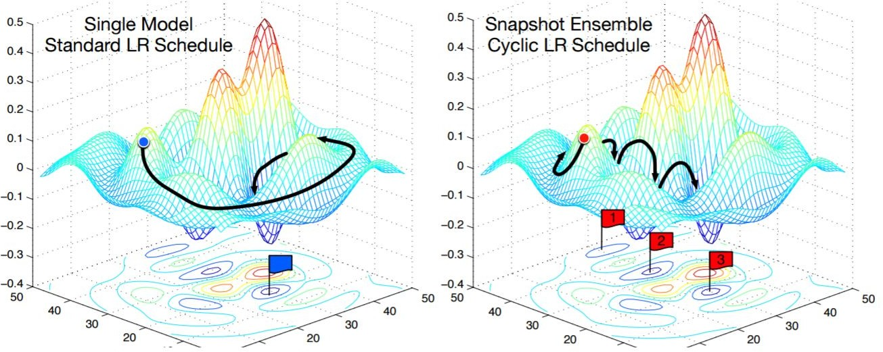
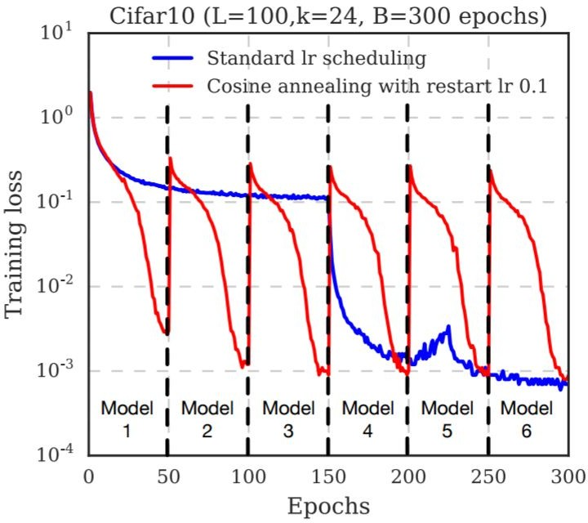
Model Ensembles: Tips and Tricks
Instead of training independent models, use multiple snapshots of a single model during training!
Loshchilov and Hutter, “SGDR: Stochastic gradient descent with restarts”, arXiv 2016 Huang et al, “Snapshot ensembles: train 1, get M for free”, ICLR 2017
Figures copyright Yixuan Li and Geoff Pleiss, 2017. Reproduced with permission.
Cyclic learning rate schedules can make this work even better!
Lecture 7 -
58
Fei-Fei Li & Justin Johnson & Serena Yeung Lecture 7 - April 24, 2018
Fei-Fei Li, Justin Johnson, Serena Yeung

Slide 47
Summary
Improve your training error:
  Optimizers
  Learning rate schedules
Improve your test error:
  Regularization
  Choosing hyperparameters
  Model ensembles
Lecture 7 -
47
Fei-Fei Li & Justin Johnson & Serena Yeung Lecture 7 - April 25, 2019
Adapted from Fei-Fei Li, Justin Johnson, Serena Yeung

